Slide 1
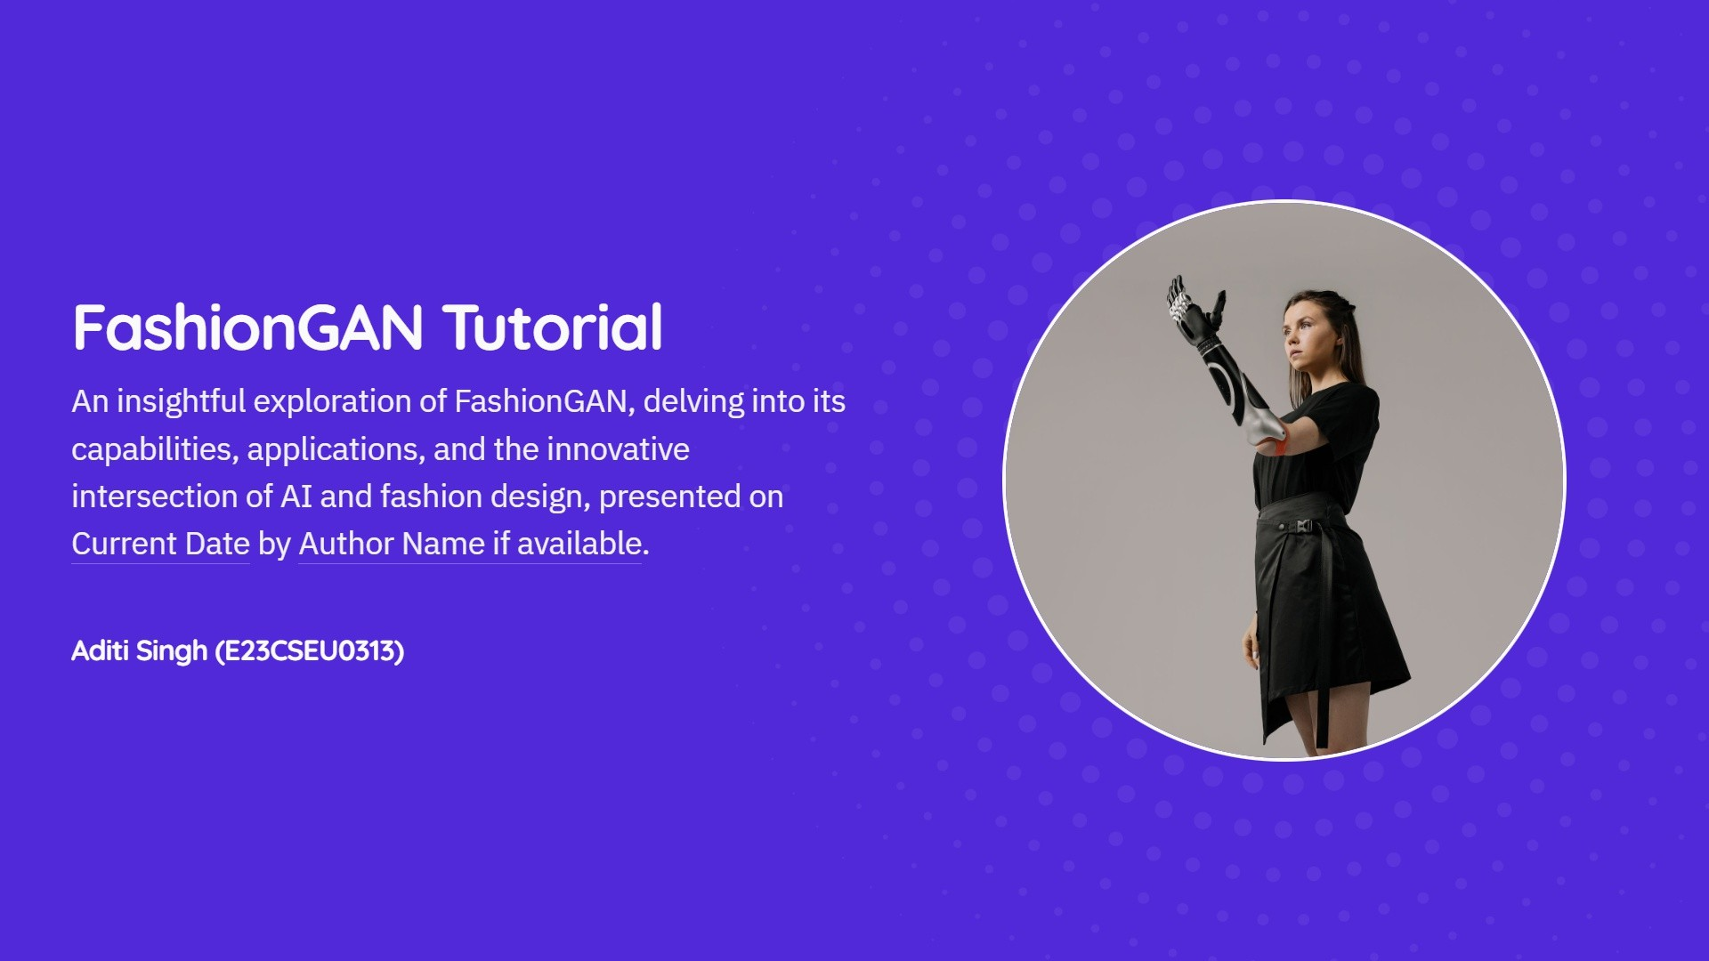


Slide 2
Intaduction to
F as h ion A I
This presentation explores the FashionGAN project, showcasing how it utilizes GANs to create innovative fashion images from the Fashion
FashionGAN
MNIST dataset using TensorFlovv and Keras.
ea
g
proseutotionsœ

Slide 3
Understanding Generative Adversarial Networks
An overview of the revolutionary GAN framework
Introduction to GANs
GANs were introduced by Ian Goodfellow in 2014, revolutionizing generative modeling.
Components of GANs
GANs consist of two networks: the Generator and the Discriminator.
Generator Network Function
The Generator creates synthetic images from random noise, simulating real data.
Discriminator Network Role
The Discriminator evaluates images, distinguishing between real and generated content.
Adversoriol Training Process
Both networks train simultaneously, improving each other's performance through competition.
Outcome of GAN Training
The Generator learns to produce highly realistic images that can deceive the Discriminator.
ea
g
proseutotionsœ

Slide 4
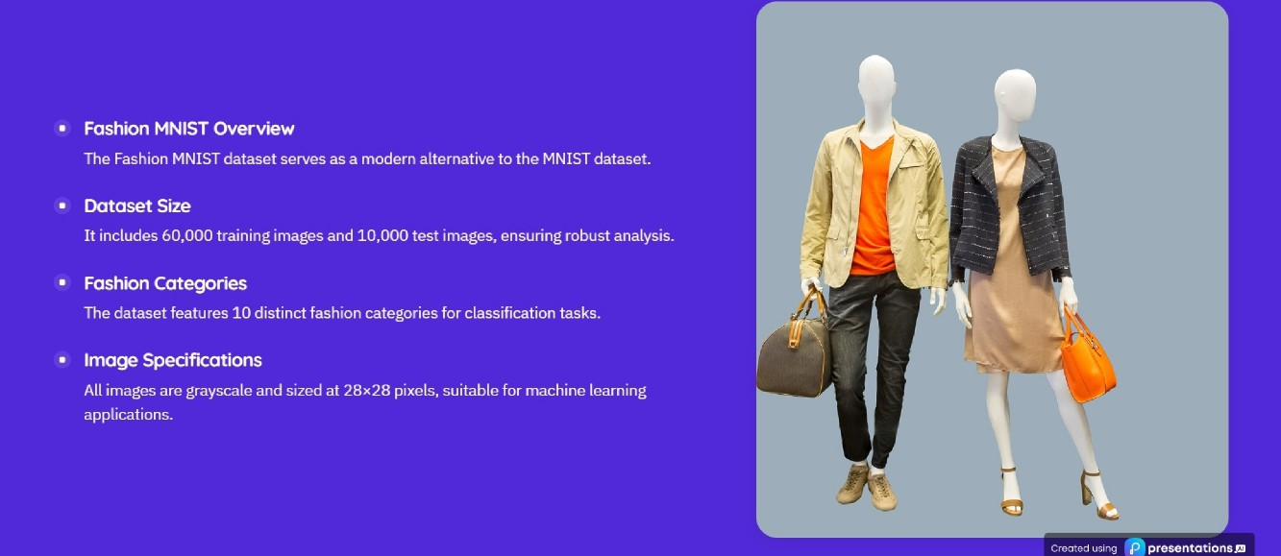
Comprehensive Overview of Fashion MNIST

Slide 5
Project împiementotion:
Environment Setup
Environment Setup
This section details the initial steps to set up the environment for our GAN project, including
importing essential libraries like TensorFlow and NumPy.
ea
g
proseutotionsœ

Slide 6
Data Preparation for Fashion
Data P re par a t i on
MNIST Dataset
This section details the loading and preprocessing steps for the Fashion MNIST dataset, crucial for effective
model training in the pro|ect.
ea
g
proseutotionsœ

Slide 7
Understanding Generator Architemure
A deep dive into the architecture of GAN generators
Input Lager
Upsompling Block 2
The generator starts witha 100-dimensional random noise vector as input.
Further increases the image size to 28x28 using 64 filters for better detail.
Dense Lager
Output Lager
First layer transforms noise intoa 7x7x256 tensor using Dense and
Final layer generates the image with pixel values scaled to -1, 1 using Tanh
BatchNormalization. activation.
Upsompling Block 1
Utilizes Conv2DTranspose to increase the size to 14x14 with 128 filters.
BotchNormolization
Enhances training stability and accelerates convergence during model
training.
LeokgReLU Activation
Applied throughout the network to allow small negative values, improving
performance.
ea
g
proseutotionsœ

Slide 8
Input Lager
Accepts images of size 28x28 with a single channel for grayscafe.
Convolutionol Lagers
Utilizes Conv2D layers for feature extraction with downsampling.
Understanding Discriminator Architecture
Key components and functions explained
Leakg ReLU Activation
Employs LeakyReLU to introduce non-linearity, helping in better learning.
Dropout Regularizotion
Incorporates Dropout layers to reduce overfitting during training.
Flattening Output
Transforms the output from convolutional layers into a single vector.
Final Dense Lager
Outputs a single value (0 or 1) indicating real or fake image.
ea ra, g
proseutotionsg

Slide 9
Training Process of
Tra i ni ng Proe ess
Generotive Adversoriol
Networks
This section outlines the training procedure for GANs, detailing the iterative training of both
the discriminator and the generator for optimal performance.
ea
g
proseutotionsœ

Slide 10
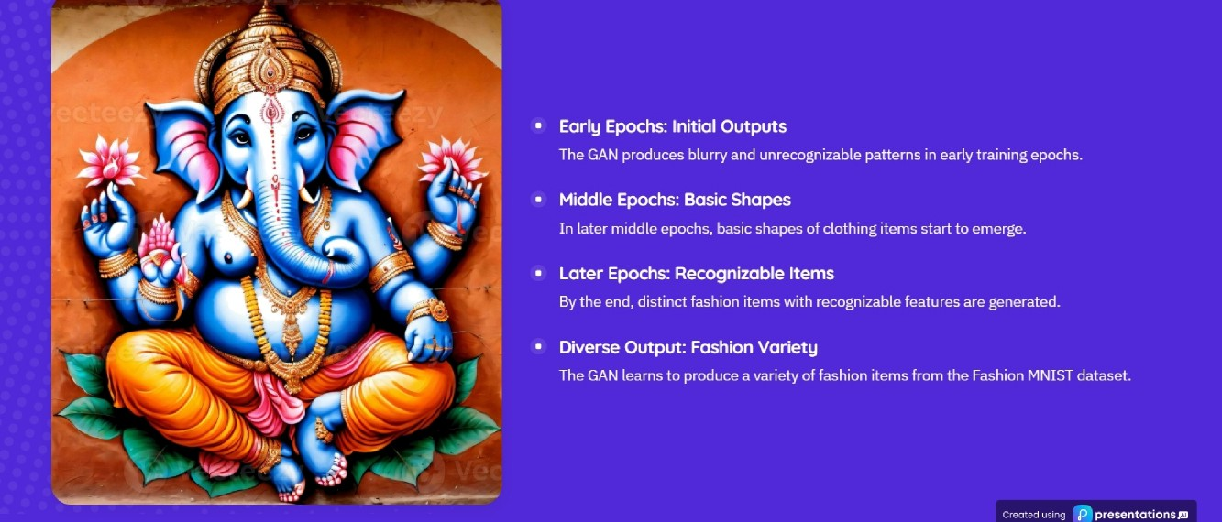
Evolution of GAN Fashion Item Generation

Slide 11
Enhancements and Applications of FøshionGAN
Exploring the potential of FashionGAN technology
Conditional GAN Implementation
Implement WGAN for enhanced
Automated Catalog Generation
Integrate class labels to create specific fashion categories for better
training stability and performance i
image generation.
Automatically generate product catalogs using FashionGAN to
*
targeting.
Progressive Growing of GANs
streamline inventory management.
DCGAN Architectural Advances
Adopt a progressive growing
Data Augmentation for
Utilize advanced convofutional architectures to improve image
technique to incrementally increase image resolution during training.
Recommendations
Use generated data to enhance
quality and generation.
Virtual Try-On Systems
fashion recommendation systems
Higher Resolution Image Generation
Develop applications that allow
and improve user experience.
Employ techniques to produce larger, high-quality fashion images
users to virtually try on clothing items before purchase.
Style Transfer Techniques
Implement style transfer to create
for better visualization.
Support for Fashion Designers
variations of fashion items based on
Wasserstein GAN Stability
Provide design assistance tools to
different styles.
help fashion designers create new
clothing ideas.
ea
g
proseutotionsœ

Slide 12
Fashion GAN
Conclusion of the
This tutorialhighlights theeffectiveimplementation of abasic GAN
FashionGAN
for generating fashion images, establishing a foundation for more sophisticated models.
Tutoriaî
ea
g
proseutotionsœ

Slide 13
Generative Adversarial
Blog
Networks (GAN)
Unlock the Future of
Dive into the exciting world of Generative Adversarial Networks in fashion design and
Fashion with GANs
creativity. Visit nicknochnack/GANBasics to get started

